Slide 1
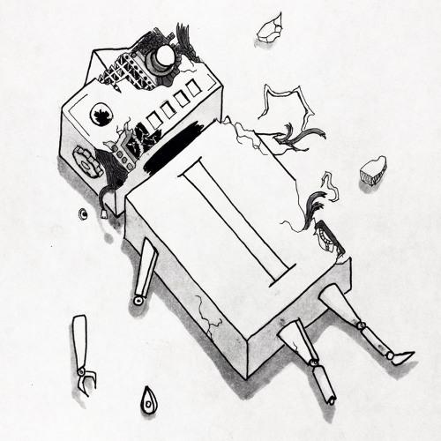
Introduction to ML

Slide 2

Beer | Bitterness | Good?
Quinarelle | 70% | Yes
Kriek | 10% | No

Slide 3
Data (Quinarelle, Kriek, etc.)
Algorithm
Function

Slide 4
New beer
1
3
Data (Quinarelle, Kriek, etc.)
Algorithm
Function
Good/not good

Slide 5
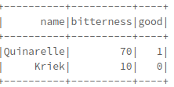
Training Dataset

Slide 6
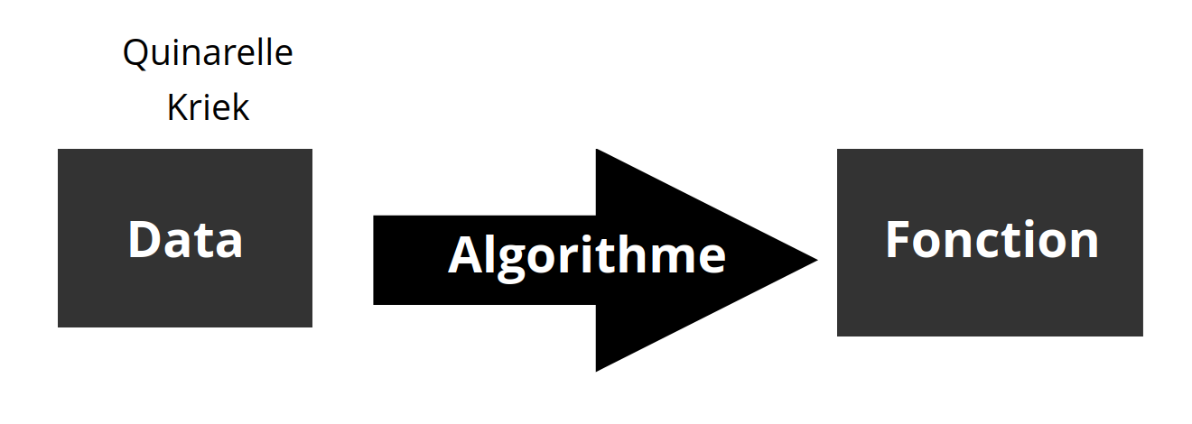

Slide 7
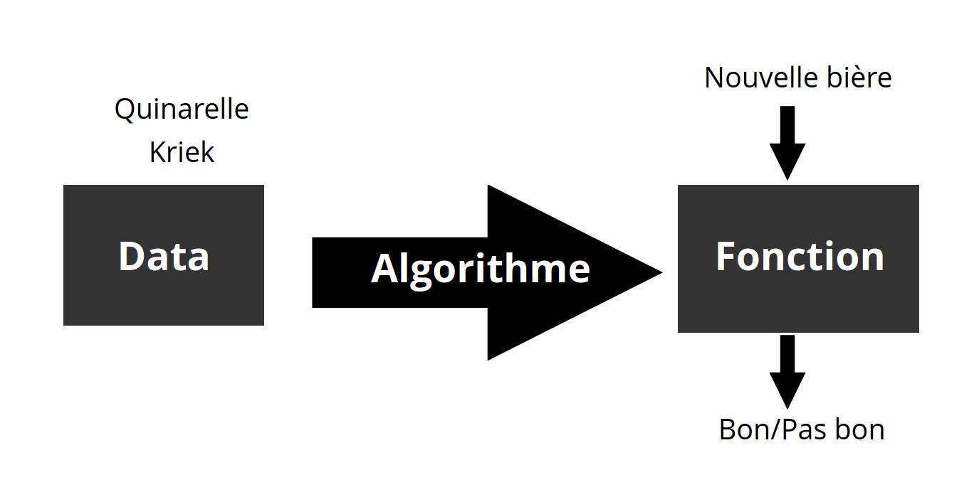

Slide 8
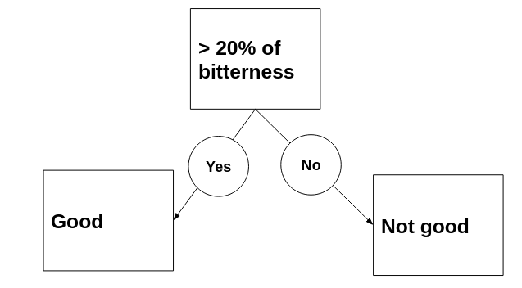

Slide 9
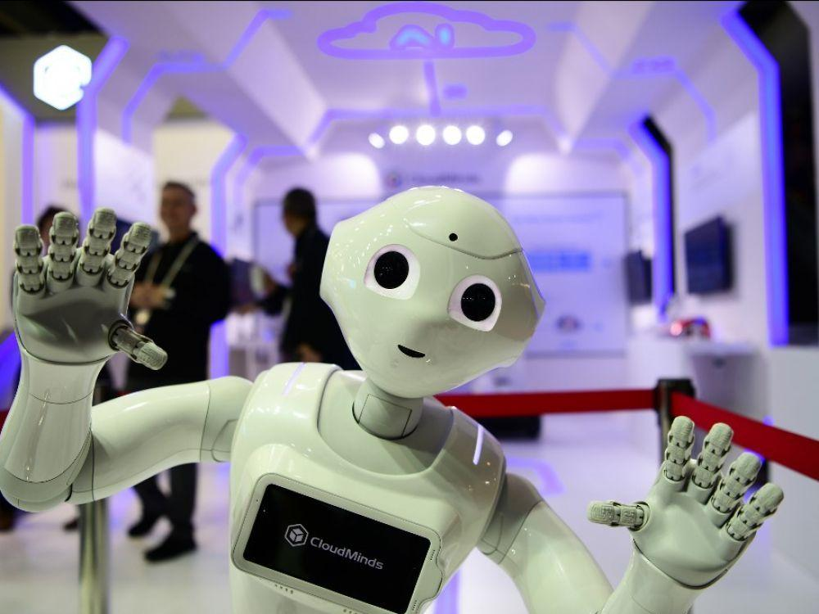
Build your environment

Slide 10
Go to https://databricks.com/try-databricks
Fill the fields and click “Get started for free”.
Follow the instructions
Click Compute > Create cluster
Enter a name and click Create cluster

Slide 11
Training data

Slide 12

Data to predict

Slide 13
Fill the blanks

Slide 14
Import the notebook fill_the_holes/demo_decison_tree_holes.ipynb
And try to fill the blanks

Slide 15
Preprocessing
Train
Use the result of the training

Slide 16
Preprocessing

Slide 17
Preprocessing: from numerical value to vector
from pyspark.ml.feature import VectorAssembler
ready_training_beers: DataFrame = VectorAssembler(inputCols=["bitterness"], outputCol="features").transform(training_beers)

Slide 18
Preprocessing
Replace x and y for:
the training dataset
the prediction dataset

Slide 19
Training

Slide 20
Training
from pyspark.ml.classification import DecisionTreeClassifier, DecisionTreeClassificationModel
decision_tree_builder: DecisionTreeClassifier = DecisionTreeClassifier(labelCol="good", featuresCol="features")
model: DecisionTreeClassificationModel = decision_tree_builder.fit(ready_training_beers)

Slide 21
Training
Replace x, y and function to replace

Slide 22
Predictions

Slide 23
Predictions
predictions: DataFrame = model.transform(ready_beers_for_predictions)

Slide 24
Predictions
Replace function to replace

Slide 25
Validation

Slide 26
Import the notebook fill_the_holes/demo_decison_tree_validation_holes.ipynb
And try to fill the blanks

Slide 27
Validation
from pyspark.ml.evaluation import MulticlassClassificationEvaluator
evaluator: MulticlassClassificationEvaluator = MulticlassClassificationEvaluator(
labelCol="good", predictionCol="prediction", metricName="accuracy")
accuracy = evaluator.evaluate(predictions)
print(accuracy)

Slide 28
Validation
Replace x, y and function to replace

